Slide 1
PIAIC
Introduction to Blockchain
Technology

Slide 2
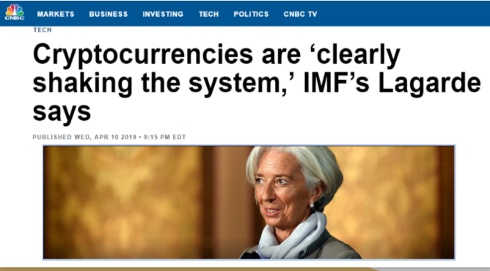
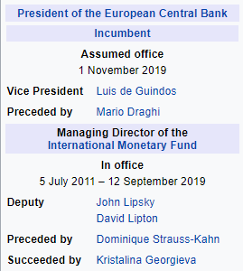
Blockchain and Crypto currencies are shaking the system

Slide 3


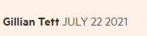
Blockchain and Crypto currencies are shaking the system
Today Swift remains a non-profit co-operative, with 11,000 members and facilitating payments worth an eye-popping $1.5tn a day. It does this not by actually moving money, but by enabling banks to dispatch messages that credit or debit their accounts as payments occur.

Slide 4

Blockchain and Crypto currencies are shaking the system

Slide 5
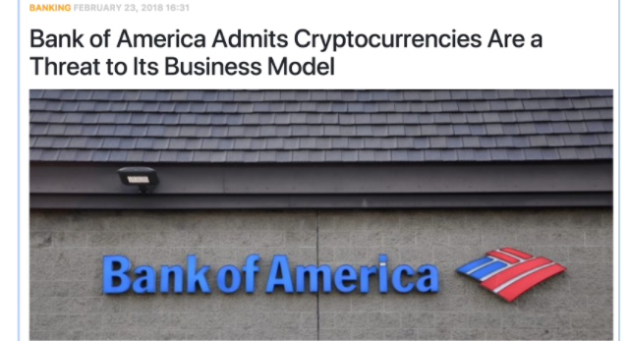
Blockchain and Crypto currencies are shaking the system

Slide 6

Blockchain and Crypto currencies are shaking the system
Investors can buy shares of an ETF to gain exposure to those securities without owning them directly.
In the case of Bitcoin ETFs, there have been two main types:
Bitcoin futures are derivative contracts speculating on the price of the cryptocurrency.
Bitcoin spot price is its current price.
Teucrium is the fourth Bitcoin futures fund to be approved, following Proshares (BITO), Valkyrie (BTF) and VanEck (XBTF) funds that all began trading late last year.
SEC Approves Bitcoin Futures ETF

Slide 7

Blockchain and Crypto currencies are shaking the system
Eight months after becoming the first country in the world to adopt bitcoin as an official currency, El Salvador has invited 44 countries to discuss the “rollout and benefits” of the cryptocurrency.
32 central banks and 12 financial authorities (44 countries) met in El Salvador to discuss financial inclusion, digital economy, banking the unbanked, the bitcoin rollout and its benefits in our country,”
SEC Approves Bitcoin Futures ETF
El Salvador became the first country in the world to adopt bitcoin as an official currency in Sep 2021
https://www.pwc.com/gx/en/financial-services/pdf/el-salvadors-law-a-meaningful-test-for-bitcoin.pdf

Slide 8


Blockchain and Crypto currencies are shaking the system

Slide 9

Blockchain and Crypto currencies are shaking the system

Slide 10
Is Blockchain Technology
The New Internet?

Slide 11
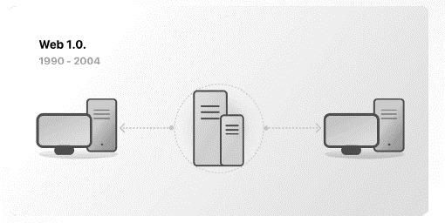
Web 1.0 : Read-Only (1990-2004)
Static websites

Slide 12
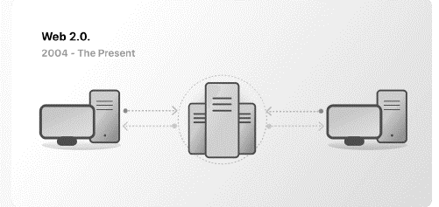
Web 2.0: Read-Write (2004-Now)
Age of “Social Media”.
YouTube, Wikipedia, Flickr & Facebook gave voice to the voiceless and a means for like-minded communities to thrive

Slide 13

Information is the New Oil
Data is the most valuable commodity in the world.
As large companies realized the value of personal information they stockpiling the data in centralized server and start selling browser habits, searches and shopping information to advertisers.
All power is accumulating with big companies.
(Facebook, Google, Apple & Amazon)
Notes:
All power with big companies (Facebook, Google, Apple & Amazon)

Slide 14
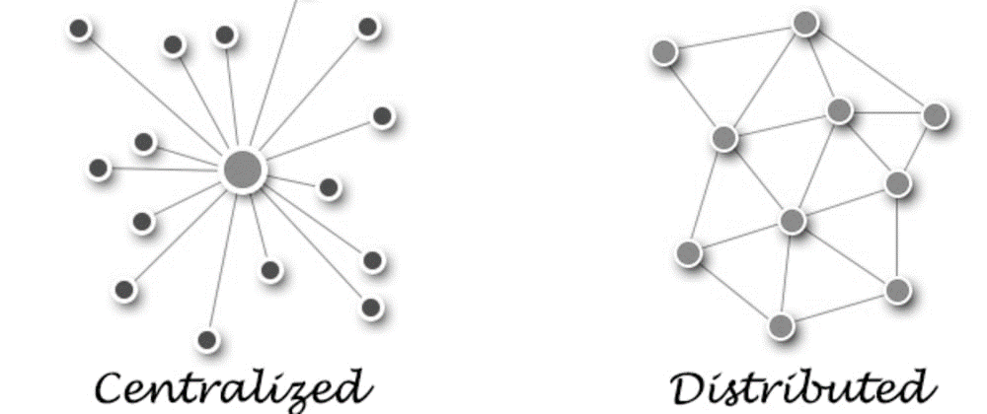
Problems in Centralization
The privacy/data of Internet user is at the stake.
Your data might be or may be sold…
Single point of failure – Hacking

Slide 15
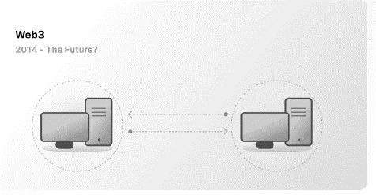
Web 3.0 is a new paradign!
Most of the internet (and the data on it) that people know and use today relies on trusting a handful of private companies to act in the public's best interests. They own the internet.
Web 3.0 uses blockchains, cryptocurrencies, and NFTs to give power back to the users in the form of ownership! It allows users to own the internet and their own data.

Slide 16

Web 3.0: Read – Write - Own
Rather than concentrating the power (and data) in the hands of huge corporates/behemoths with the questionable motives, it would be returned the rightful owners.
Decentralization was the idea, blockchain was the means
Blockchain can make you, owner of your data

Slide 17

Web 3.0: Read – Write - Own
Web 3.0 is permissionless: everyone has equal access to participate in Web3, and no one gets excluded.
Web 3.0 has native payments: it uses cryptocurrency for spending and sending money online instead of relying on the outdated infrastructure of banks and payment processors.
Web 3.0 is trustless: it operates using incentives and economic mechanisms instead of relying on trusted third parties.

Slide 18
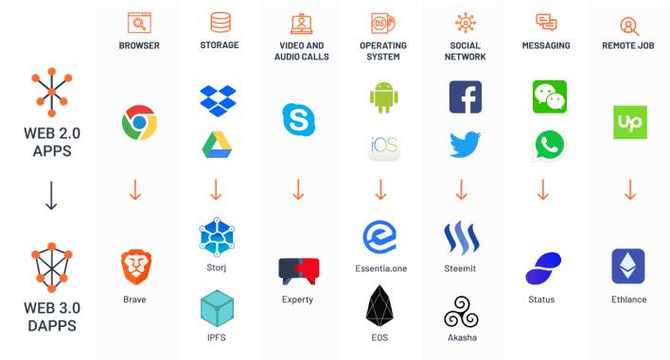
Web 3.0 Dapps

Slide 19
Industries than can be Disrupted by the Blockchain
Banking & Payments
Supply chain Management
IOT
Insurance
Private Transport and Ride Sharing
Online Data Storage
Charity
Governance
Healthcare
Online Music
Retail
Crowdfunding
ID Management
Voting

Slide 20
Distributed Network
Distributed networks a higher level of security,
To carry out malicious attacks would have to attack a large number of nodes at the same time.
As the information is distributed among the nodes of the network: if some illegitimate change is made, the rest of the nodes will be able to detect it and will not validate this information.
Consensus between nodes protects the network from deliberate attacks or accidental changes of information.

Slide 21

It all started with Idea: A Digital Currency
David Chaum first proposed the concept of E-Cash in 1982
David Chaum then founded a company called Digi Cash
It uses cryptography security and anonymity
Idea has some problem as with traditional currency,
it requires central clearing house or single point of trust
DigiCash declared bankruptcy in 1998
Many other tried faced the same fate
https://www.vice.com/en/article/j5nzx4/what-was-the-first-blockchain

Slide 22
Story of Digital Cash
DigiCash (David Chaum) – 1989
Mondex (National Westminster Bank) - 1993
CyberCash (Lynch, Melton, Crocker & Wilson) – 1994
E-gold (Gold & Silver Reserve) – 1996
Hashcash (Adam Back) – 1997 (Hashing and Cryptography usage)
Bit Gold (Nick Szabo) – 1998 (Smart Contract)
B-Money (Wei Dai) - 1998 (Earlier version of Bitcoin)
Lucre (Ben Laurie) – 1999
Notes:
Ali Pay
MPeso
In 19th Century in America 5000 different currencies (Note) are in circulation

Slide 23
Why is there so much hype around blockchain technology?
There have been many unsuccessful attempts to create digital money in past
The prevailing issue is trust. If someone creates a new currency called X dollar, how can we trust that they won't give themselves million X dollars, or steal your X dollars for themselves?
Bitcoin was designed to solve this problem using specific type of database called blockchain.
Most normal databases, i.e. SQL database, have someone in charge who can change the entries (e.g. giving themselves a million X dollars).
Blockchain is different because nobody is in charge; it’s run by the people who use it.
What’s more, bitcoins can’t be faked, hacked or double spent – so people that own this money can trust that it has some value.
Notes:
Decentralization:
In simple terms, it means that the application or service continues to be available and usable even if a server or a group of servers on a network crashes or is not available. The service or application is deployed on a network in a way that no server has absolute control over data and execution, rather each server has a current copy of data and execution logic.
Distributed:
This means that any server or node on a network is connected to every other node on the network. Rather than having one-to-one or one-to-many connectivity between servers, servers have many-to-many connections with other servers.
Database:
This refers to the location for storing durable data that can be accessed at any point in time. A database allows storage and retrieval of data as functionality and also provides management functionalities to manage data efficiently, such as export, import, backup, and restoration.
Ledger:
This is an accounting term. Think of it as specialized storage and retrieval of data. Think of ledgers that are available to banks.

Slide 24
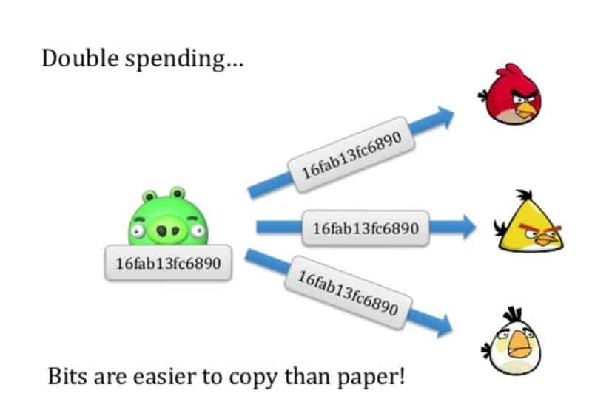
Double Spend Problem
The Double Spend Problem describes the difficulty of ensuring digital money is not easily duplicated.
Notes:
Decentralization:
In simple terms, it means that the application or service continues to be available and usable even if a server or a group of servers on a network crashes or is not available. The service or application is deployed on a network in a way that no server has absolute control over data and execution, rather each server has a current copy of data and execution logic.
Distributed:
This means that any server or node on a network is connected to every other node on the network. Rather than having one-to-one or one-to-many connectivity between servers, servers have many-to-many connections with other servers.
Database:
This refers to the location for storing durable data that can be accessed at any point in time. A database allows storage and retrieval of data as functionality and also provides management functionalities to manage data efficiently, such as export, import, backup, and restoration.
Ledger:
This is an accounting term. Think of it as specialized storage and retrieval of data. Think of ledgers that are available to banks.

Slide 25
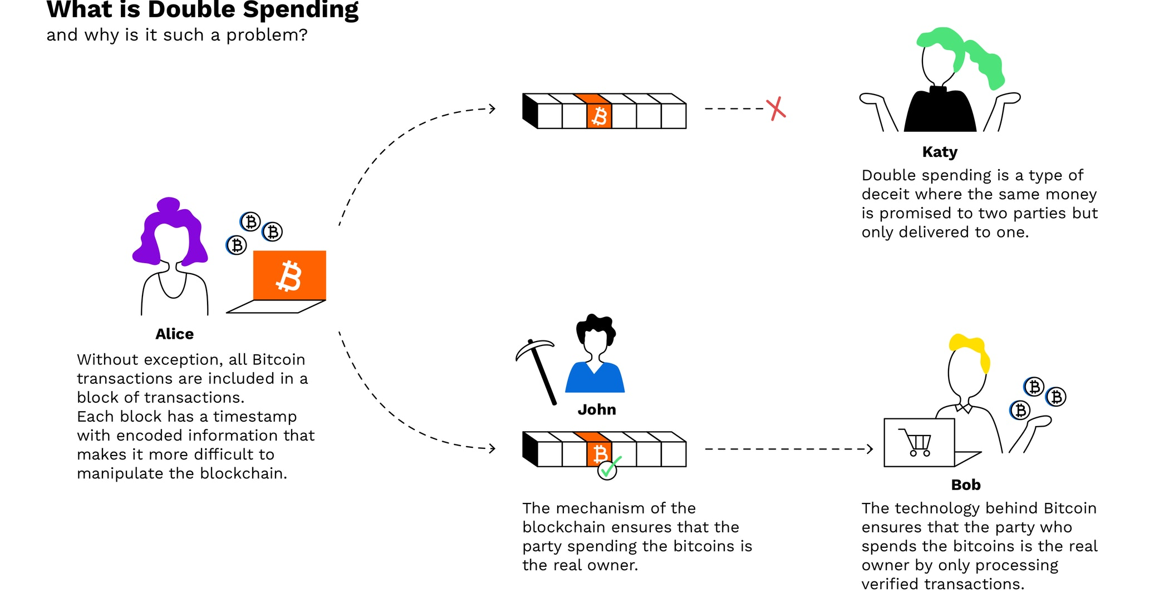
Double Spend Problem
Notes:
Decentralization:
In simple terms, it means that the application or service continues to be available and usable even if a server or a group of servers on a network crashes or is not available. The service or application is deployed on a network in a way that no server has absolute control over data and execution, rather each server has a current copy of data and execution logic.
Distributed:
This means that any server or node on a network is connected to every other node on the network. Rather than having one-to-one or one-to-many connectivity between servers, servers have many-to-many connections with other servers.
Database:
This refers to the location for storing durable data that can be accessed at any point in time. A database allows storage and retrieval of data as functionality and also provides management functionalities to manage data efficiently, such as export, import, backup, and restoration.
Ledger:
This is an accounting term. Think of it as specialized storage and retrieval of data. Think of ledgers that are available to banks.

Slide 26

What is Blockchain
“The blockchain is an incorruptible digital ledger of economic transactions that can be programmed to record not just financial transactions but virtually every thing of value.”
- Don & Alex Tapscott, authors Blockchain Revolution (2016)

Slide 27
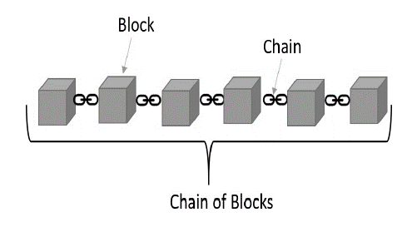
What is a blockchain?
Blockchain is a time-stamped series of immutable record of data is managed by cluster of computers not owned by any single entity. Each of these blocks of data are secured and bound to each other using cryptographic principles
Notes:
Blockchain is nothing more than a creative amalgamation of many old concepts, technologies, and methodologies. These components include ledgers, cryptography, group consensus, immutability and more.

Slide 28
What is a blockchain?
Stable, Robust & Durable,
No single point of failure.
No single node/server is the data owner
Everyone participates as a stakeholder and get financial rewards.
No one can change / modify past transactions
Highly trustworthy, transparent, and incorruptible.
Ethereum also allows extending its functionality with the help of smart contracts.
Notes:
Decentralization:
In simple terms, it means that the application or service continues to be available and usable even if a server or a group of servers on a network crashes or is not available. The service or application is deployed on a network in a way that no server has absolute control over data and execution, rather each server has a current copy of data and execution logic.
Distributed:
This means that any server or node on a network is connected to every other node on the network. Rather than having one-to-one or one-to-many connectivity between servers, servers have many-to-many connections with other servers.
Database:
This refers to the location for storing durable data that can be accessed at any point in time. A database allows storage and retrieval of data as functionality and also provides management functionalities to manage data efficiently, such as export, import, backup, and restoration.
Ledger:
This is an accounting term. Think of it as specialized storage and retrieval of data. Think of ledgers that are available to banks.

Slide 29
What is Blockchain - Detail
Blockchain is a system of recording information in a way that makes it difficult or impossible to change, hack, or cheat the system.
A blockchain is essentially a distributed ledger of transactions that is duplicated and distributed across the entire network of computer systems on the blockchain.
Each block in the chain contains a number of transactions, and every time a new transaction occurs on the blockchain, a record of that transaction is added to every participant’s ledger.
The decentralised database managed by multiple participants is known as Distributed Ledger Technology (DLT).

Slide 30
What is Blockchain – Detail Cont…
Blockchain is a type of DLT in which transactions are recorded with an immutable cryptographic signature called a hash.
This means if one block in one chain was changed, it would be immediately apparent it had been tampered with.
If hackers wanted to corrupt a blockchain system, they would have to change every block in the chain, across all of the distributed versions of the chain.
Blockchains such as Bitcoin and Ethereum are constantly and continually growing as blocks are being added to the chain, which significantly adds to the security of the ledger

Slide 31
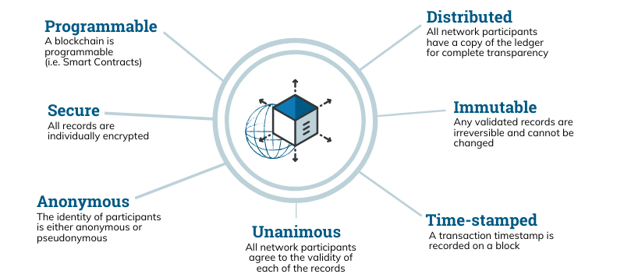
Distributed Ledger Technology

Slide 32

Bitcoin
In 2008 a white paper was published “Bitcoin: A Peer-to-Peer Electronic Cash System.” by Satoshi Nakamoto
In 2009 first ever block of bitcoin, known as Genesis Block was mined
Bitcoin uses:
- Secure digital signatures
- Not requiring the use of a third party
- Proof of work
- Hashing the transactions together to form a chain
Satoshi Nakamoto is unknown person or group of people, wrote the Bitcoin paper
Satoshi Disappears in December 2010

Slide 33

Bitcoin Properties
Decentralized – Peer to peer ledger of balances
Immutable – can never be changed, transactions are permanent
Fungible - each BTC is equal, maintain it value
Permission less and without borders – anyone can participate by downloading software
Divisible – down to 8 decimal places
Scarcity – 21 million coins ever
Transferrable – can send any amount in seconds

Slide 34
What is a Bitcoin?
A collection of concepts and technologies.
It behaves like conventional currencies
Can be purchased, sold & exchanged for other currencies at specialized exchanges.
They are completely virtual with no physical existence.
Fast, Secure & Borderless

Slide 35

Pizza for Bitcoin
May 22, 2010, 07:17:26 PM
“I just want to report that I successfully traded 10,000 bitcoins for pizza”
Value:
• May 22, 2010 - $41
• $20.50 per pizza

Slide 36
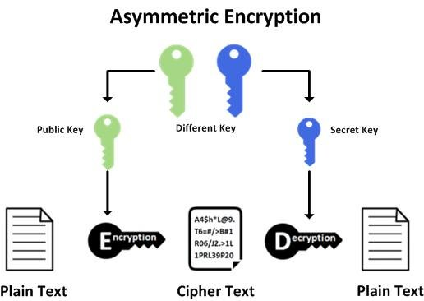
Asymmetric Cryptography
Using two keys for encryption and decryption.
Any key can be used for encryption and decryption.
Message encryption with a public key can be decrypted using a private key and messages encrypted by a private key can be decrypted using a public key.
Notes:
As long as there have been two or more people on Earth who wished to keep a secret from someone else, there has been cryptography.
In blockchain we use cryptography to protect anonymity, to provide ledger immutability, and to validate claims that people make against assets tracked and managed on the blockchain.

Slide 37
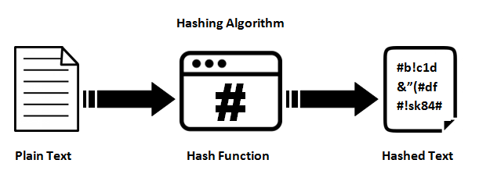
Hashing
Is the process of transforming any input data into fixed length random character data, and it is not possible to regenerate or identify the original data from the resultant string data.
Hashes are also known as fingerprint of input data. It is next to impossible to derive input data based on its hash value.
Hashing ensures that even a slight change in input data will completely change the output data, and no one can ascertain the change in the original data.
Another important property of hashing is that no matter the size of input string data, the length of its output is always fixed.This can especially become useful when large amounts of data can be stored as 256 bit output data

Slide 38
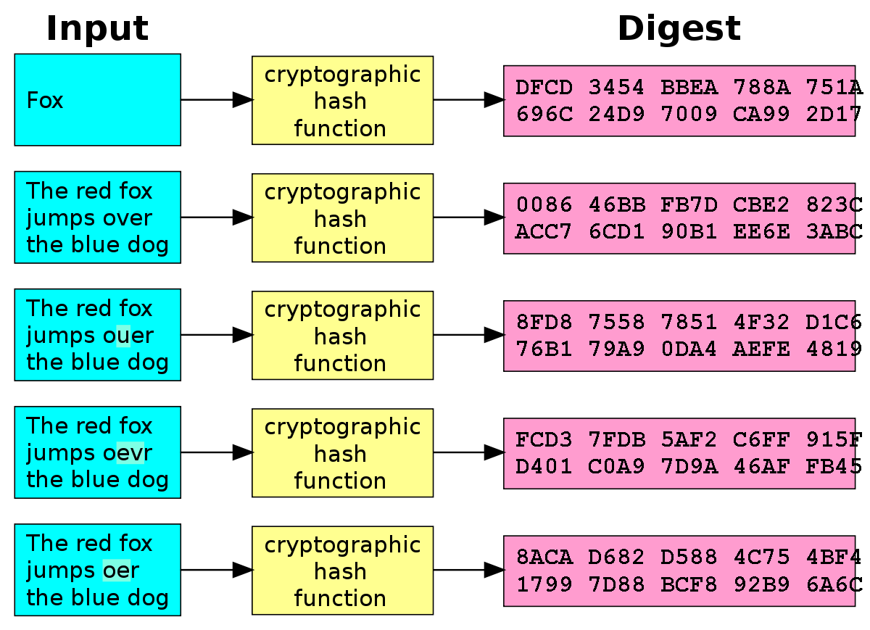
Hashing - Example

Slide 39
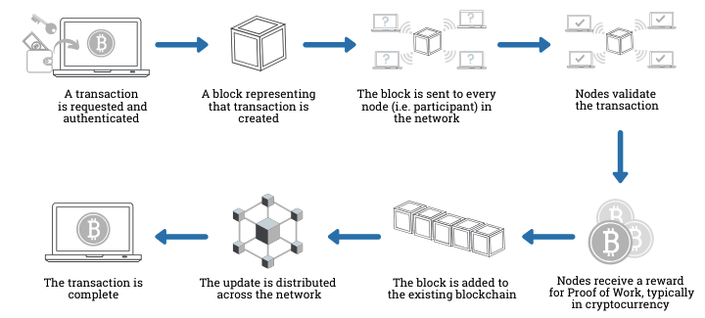
How does a transaction get into blockchain

Slide 40
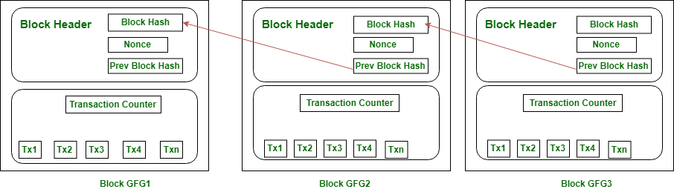
Block in Blockchain

Slide 41
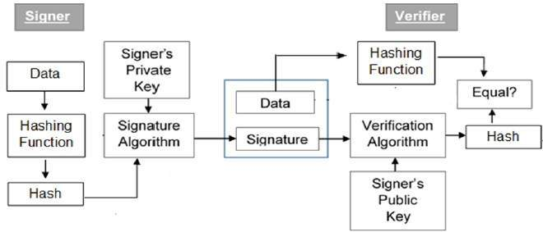
Public Vs Private Key, Hash, Signer & Verifier

Slide 42
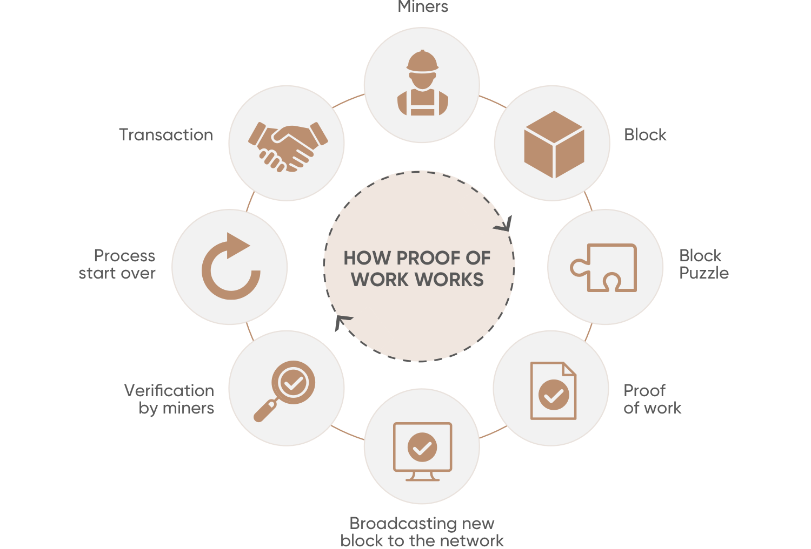
Proof of Work

Slide 43
How proof of work enables trustless consensus
The main innovation that Satoshi Nakamoto introduced is using so-called proof of work (POW) to create distributed trustless consensus and solve the double-spend problem.
POW is not a new idea, but the way Satoshi combined this and other existing concepts — cryptographic signatures, merkle chains, and P2P networks — into a viable distributed consensus system.
POW is a requirement that expensive computations, also called mining, to be performed in order to facilitate transactions on the blockchain.
To understand the link between computational difficulty and trustless consensus within a network implementing a distributed cryptocurrency system is a serious mental feat. With this writing I hope to help those who are attempting it.

Slide 44
Mining Nodes
A miner is responsible for writing transactions to the chain.
A miner's job is very similar to that of an accountant.
As an accountant is responsible for writing and maintaining the ledger;
Solely responsible for writing a transaction to an Ethereum ledger.
A miner is interested in writing transactions to a ledger because of the reward associated with it.
Miners get two types of reward—a reward for writing a block to the chain and cumulative gas fees from all transactions in the block

Slide 45
How Mining Works
Miner constructs a new block & adds all transactions to it.
Before adding these transactions, it will check if any of the transactions are not already written in a block that it might receive from other miners.
If so, it will discard those transactions

Slide 46

How Block Header is created
1. The miner takes hashes of two transactions at a time to generate a new hash till he gets a single hash from all transactions. The hash is referred to as a Merkle root transaction hash. This hash is added to the block header.
2. Miner also identifies the hash of the previous block. Previous block will become parent to the current block and its hash will also be added to the block header.
3. Miner calculates the state and receipts of transaction root hashes & adds them to block header
4. A nonce and timestamp is also added to the block header.
5. Eventually, one of the miners will be able to solve the puzzle and advertise the same to other miners in the network. The other miners will verify the answer and, if found correct, will further verify every transaction, accept the block, and append the same to their ledger instance.

Slide 47
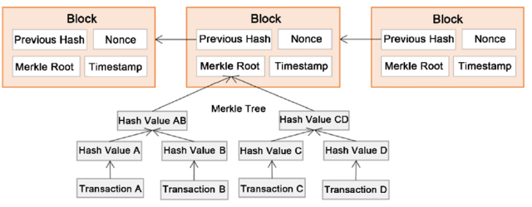
Block Structure

Slide 48
Ether
Ether is the currency of Ethereum.
Every activity on Ethereum that modifies its state costs Ether as a fee
Successful miners are also rewarded Ether.
Converted to dollars or other traditional currencies through cryptoexchanges.
Ethereum has a metric system of denominations used as units of Ether. The smallest denomination of Ether is called wei

Slide 49
Ethereum Accounts
Are the main building blocks for the Ethereum ecosystem.
It is an interaction between accounts that Ethereum wants to store as transactions in its ledger.
There are two types of accounts available in Ethereum
—Externally owned accounts and —Contract accounts.
Each account, by default, has a property named balance that helps in querying the current balance of Ether.

Slide 50

Transaction
Is an agreement between a buyer and a seller that there will be an exchange of assets, products, or services for currency, cryptocurrency, or some other asset
Following are the three types of transactions that can be executed in Ethereum:
Transfer of Ether from one account to another:
Following are the possible cases:
An EOA sending Ether to another EOA in a transaction
An EOA sending Ether to a contract account in a transaction
A contract account sending Ether to another contract account in a transaction
A contract account sending Ether to an EOA in a transaction

Slide 51
Transaction
2. Deployment of a smart contract:
An EOA can deploy a contract using a transaction in EVM.
3. Using or invoking a function within a contract:
Executing a function in a contract that changes state is considered a transaction in Ethereum.
If executing a function does not change a state, it does not require a transaction.

Slide 52
Transaction - Account Properties
“from” denotes the account that is originating the transaction and represents an account that is ready to send some gas or Ether. The from account can be externally owned or a contract account.
“to” refers to an account that is receiving Ether or benefits in lieu of an exchange. For transactions related to deployment of contract, the to field is empty. It can be externally owned or a contract account.
“value”refers to the amount of Ether that is transferred from one account to another.
“input” refers to the compiled contract bytecode and is used during contract deployment in EVM. It is also used for storing data related to smart contract function calls along with its parameters.

Slide 53
Transaction - Account Properties
“blockHash” - hash of block to which this transaction belongs.
“blockNumber” - is the block in which this transaction belongs.
hash“gas” - amount of gas supplied by the sender who is executing this transaction.
“gasPrice” - price per gas the sender was willing to pay in wei. (Total gas is computed at gas units * gas price).
“hash” - hash of the transaction.

Slide 54
Transaction - Account Properties
“nonce” - number of transactions made by the sender prior to the current transaction.
“transactionIndex” - serial number of current transactions in the block.
“value” - amount of Ether transferred in wei.
“v, r, and s” - relate to digital signatures and the signing of the transaction.

Slide 55

What is Contract
A contract is a legal document that binds two or more parties who agree to execute a transaction immediately or in the future
Since contracts are legal documents, they are enforced and implemented by law.

Slide 56
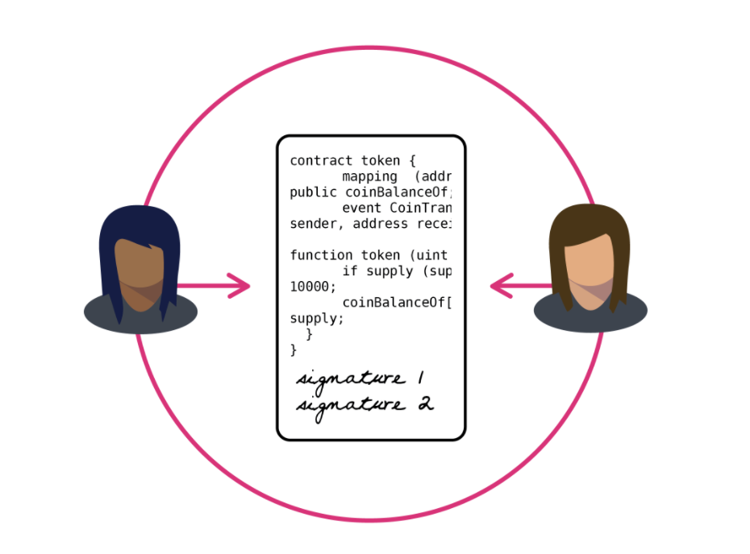
What is Smart Contract
Custom logic and code deployed and executed within an Ethereum virtual environment.
Digitized and codified rules of transaction between accounts.
Help in transferring digital assets between accounts as an atomic transaction.
Smart contracts can store data.

Slide 57
How to write smart contracts?
Easiest and fastest way to develop smart contracts is to use a browser-based tool known as Remix. http://remix.ethereum.org.
Remix provides a rich integrated development environment in a browser for authoring, developing, deploying, and troubleshooting contracts written using the Solidity language.
All contract management related activities such as authoring, deploying, and troubleshooting can be performed from the same environment without moving to other windows or tabs.

Slide 58
How to write smart contracts?
Easiest and fastest way to develop smart contracts is to use a browser-based tool known as Remix. http://remix.ethereum.org.
Remix provides a rich integrated development environment in a browser for authoring, developing, deploying, and troubleshooting contracts written using the Solidity language.
All contract management related activities such as authoring, deploying, and troubleshooting can be performed from the same environment without moving to other windows or tabs.

Slide 59
Remix - IDE
Compile tab compiles the contract into bytecode
Run tab is the place where you will spend the most time, apart from writing the contract. The Run tab allows you to deploy the contract to this runtime using the JavaScript VM environment in the Environment option
Injected Web3 environment is used along with tools such as Mist and MetaMask, which will be covered in the next chapter, and Web3 Provider can be used when using Remix in a local environment connecting to private network. In our case for this chapter, the default, JavaScript VM is sufficient.

Slide 60
Chapter # 2
Installing Ethereum and Solidity

Slide 61
Ethereum Networks
An Open Source Platform for Creating and Deploying Distributed Applications.
Backed up by a large number of computers (Nodes)
All Nodes are interconnected and storing data in a distributed ledger.(Each Node)
Choose an appropriate network based on their requirements and use cases.
Different networks help in deploying solutions and smart contracts on networks that do not actually cost any Ether or money.

Slide 62
Ethereum Networks
Main Ethereum Network is a global public network that anybody can use.
Main network incurs costs in terms of Gas
Main network is known as Homestead
Anybody can connect to it and access both Data and Transactions stored in it
Test Network help to facilitate and increase adoption of the Ethereum blockchain.
Exact Replica of the main network
Does not cost anything for deployment and usage of contracts
Test Ethers can be generated using faucets and used on these networks
Multiple test networks available at the time of writing, such as Ropsten, Kovan, and Rinkeby

Slide 63
Ethereum Networks
Private Network is created and hosted on a private infrastructure.
Are controlled by a single organization and they have full control over it.
There are solutions, contracts, and use cases that an organization might not want to put on a public network even for test purposes.
They want to use private chains for development, testing, and production environments.
Organizations should create and host a private network and they will have full control over it

Slide 64
Ethereum Networks
Consortium network is also a private network, however, with a difference.
Consortium network comprises nodes, each managed by a different organization.
In effect, no organization has a control over the data and chain.
However, it is shared within the organization and everyone from these organizations can view and modify the current state.
These might be accessible through the internet or completely private networks using VPN

Slide 65
Chapter # 3
Introducing
Solidity

Slide 66
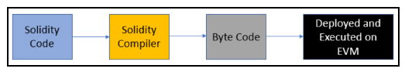
Solidity Compiler & EVM
EVM executes code that is part of smart contracts.
Smart contracts are written in Solidity;
However, EVM does not understand Solidity.
EVM understands bytecode.
Solidity comes with a SOLC which translate Solidity into Bytecode

Slide 67
Solidity & Solidity files
Solidity is a programming language that is very close to JavaScript
Solidity is a statically-typed, case-sensitive, and object-oriented
programming (OOP) language.
A Solidity file is composed of the following four high-level
constructs:
Pragma
Comments
Import
Contracts/library/interface

Slide 68
Pragma and Compiler version
Pragma is generally the first line of code within any Solidity file.
pragma is a directive that specifies the compiler version to be used for
current Solidity file.
Although it is not mandatory, it is a good practice to declare the pragma directive as the first statement in a Solidity file.
The syntax for the pragma directive is as follows:
The version number comprises of two numbers
a major build and a minor build number.
0.5.0

Slide 69
Pragma and Compiler version
The ^ character, also known as caret, is optional in version numbers but plays a significant role in deciding the version number based on the following rules:
The ^ character refers to the latest version within a major version. So, ^0.5.0 refers to the latest version within build number 4, which currently would be 0.5.11.
The ^ character will not target any other major build apart from the one that is provided.
The Solidity file will compile only with a compiler with 4 as the major build. It will not compile with any other major build.
As a good practice, it is better to compile Solidity code with an exact compiler version rather than using ^

Slide 70
Comments
Single-line comments
// This is a single-line comment in Solidity
Multiline comments
/* This is a multiline comment In Solidity. Use this when multiple consecutive lines Should be commented as a whole */
Ethereum Natural Specification (Natspec)
Natspec is used for documentation purposes and it has its own specification.

Slide 71
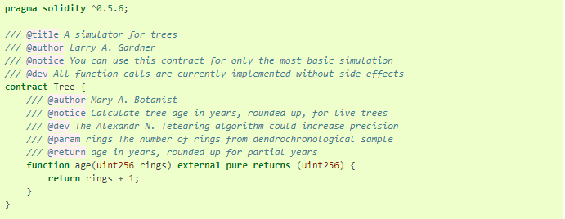
Comments - NetSpecs
For more information https://solidity.readthedocs.io/en/v0.5.10/natspec-format.html

Slide 72
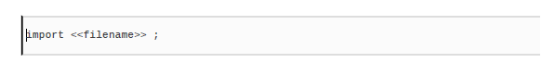
The import statement
The import keyword helps import other Solidity files and we can access its code within the current Solidity file and code.
This helps us write modular Solidity code.
File names can be fully explicit or implicit paths

Slide 73
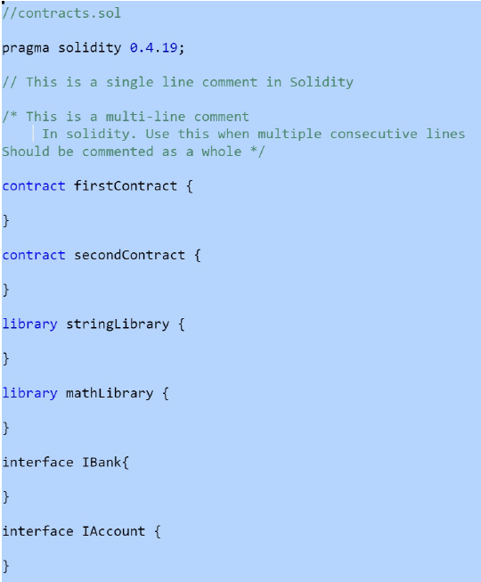
Contracts
Apart from pragma, import, and comments, we can define contracts, libraries, and interfaces at the global or top level.
The multiple contracts, libraries, and interfaces can be declared within the same Solidity file.

Slide 74
Structure of a contract
A contract consists of the following multiple constructs:
State variables
Structure definitions
Modifier definitions
Event declarations
Enumeration definitions
Function definitions
Notes:
Technically contracts are composed of two constructs—variables and functions

Slide 75
State variables
Variables in programming refer to storage location that can contain values.
These values can be changed during runtime.
The variable can be used at multiple places within code and they will all refer to the value stored within it.
Solidity provides two types of variable — State variable and — Memory variables.
State variables are permanently stored in a blockchain ledger by miners.
Variables declared in a contract that are not within any function are called state variables.
State variables store the current values of the contract.
The allocated memory for a state variable is statically assigned and it cannot change during the lifetime of the contract.
Each state variable has a type that must be defined statically.
Notes:
Technically contracts are composed of two constructs—variables and functions

Slide 76
State variables
State variables also have additional qualifiers associated with them.
internal: By default, (if nothing is specified). Can only be used within current contract functions and any contract that inherits from them. These variables cannot be accessed from outside for modification; however, they can be viewed. int internal StateVariable ;
private: like internal with additional constraints. Can only be used in contracts declaring them. They cannot be used even within derived contracts. int private privateStateVariable ;
Notes:
Technically contracts are composed of two constructs—variables and functions

Slide 77
State variables
public: This qualifier makes state variables access directly.
The Solidity compiler generates a getter function for each public state variable. An example of a public state variable is as follows:
int public stateIntVariable ;
constant: This qualifier makes state variables immutable.
Value must be assigned at declaration time itself. In fact, the compiler will replace references of this variable everywhere in code with the assigned value.
bool constant hasIncome = true;
Notes:
Technically contracts are composed of two constructs—variables and functions

Slide 78
Data Types
Solidity provides the following multiple out-of-box data types:
bool
uint/int
bytes
address
mapping
enum
struct
bytes/String
Using enum and struct, it is possible to declare custom user-defined data types as well.
Notes:
Technically contracts are composed of two constructs—variables and functions

Slide 79
Literals
Solidity provides usage of literal for assignments to variables. Literals do not have names; they are the values themselves. Variables can change their values during a program execution, but a literal remains the same value throughout
Examples:
Integer literal are 1, 10, 1,000, -1, and -100.
String literals are "Ritesh" and 'Modi'.
Address literals are 0xca35b7d915458ef540ade6068dfe2f44e8fa733c
Hexadecimal literals is hex"1A2B3F".
Decimal literals 4.5 and 0.2.

Slide 80
Integers
Integers help in storing numbers in contracts
Signed integers: Signed integers can hold both negative and positive values.
Unsigned integers: Unsigned integers can hold only positive values along with zero. They can also hold negative values apart from positive and zero values
There are multiple flavors of integers in Solidity. Depending on requirements, an appropriately sized integer should be chosen

Slide 81
Integers - Flavours
Solidity provides uint8 type to represent 8 bit unsigned integer and thereon in multiples of 8 till it reaches 256.
There could be 32 different declarations of uint with different multiples of of 8, such as uint8, uint16, unit24, as far as uint256 bit.
While storing values between 0 and 255 uint8 is appropriate, and while storing values between -128 to 127 int8 is more suitable.
The default value for both signed and unsigned integers is zero
Integers are value types; however, when used as an array they are referred as reference types.

Slide 82
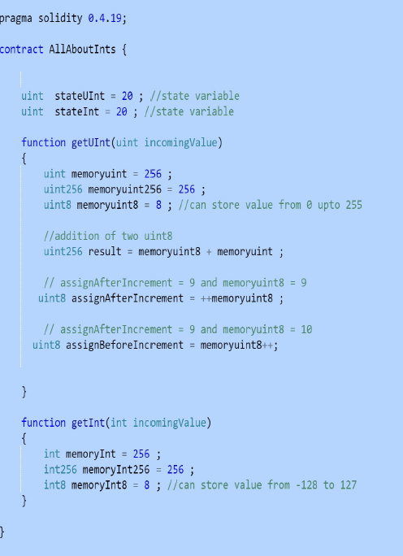
Integer
Mathematical operations such as addition, subtraction, multiplication, division, exponential, negation, post-increment, and pre-increment can be performed on integers.

Slide 83
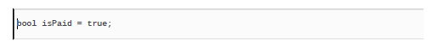
Boolean
The bool data type can be used to represent scenarios that have binary results, such as true or false.
It is to be noted that bools in Solidity cannot be converted to integers, like javascript.
It's a value type and any assignment to other boolean variables creates a new copy. The default value for bool in Solidity is false.

Slide 84
Bytes
Byte refers to 8 bit signed integers. Everything in memory is stored in bits consisting of binary values—0 and 1.
The byte data type also used to store information in binary format.
It provides data types in the range from bytes1 to bytes32
These are called fixed sized byte arrays and are implemented as value types
bytes1 = 1 byte bytes2 = 2 bytes.
The default value for byte is 0x00

Slide 85
Bytes: Assignments
Hexadecimal:
Integer:
Negative Integer:
Character:
😊
bytes1 aa = 0x65;
😊
bytes1 aa = 8;
😊
bytes1 aa = -8;
😊
bytes1 aa = ‘a’;
We can also perform bitwise operations such as and, or, xor, not, and left and right shift operations on the byte data type:

Slide 86
Arrays
Arrays refer to groups of values of the same type.
Arrays help in storing these values together and ease the process of iterating, sorting, and searching for individuals or subsets of elements within this group

Slide 87
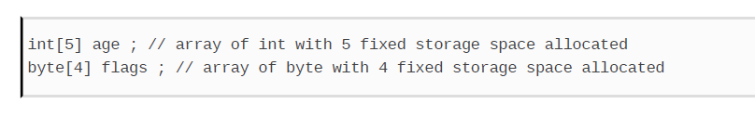
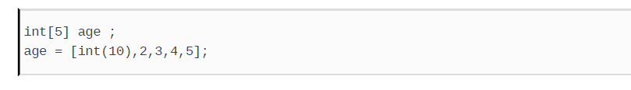
Fixed Arrays
Fixed arrays refer to arrays that have a pre-determined size mentioned at declaration.

Slide 88
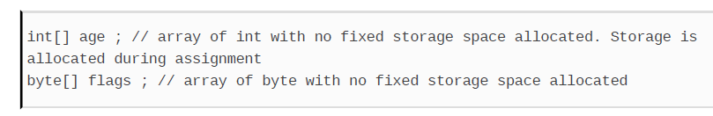
Dynamic Array
Arrays that do not have a pre-determined size at the time of declaration; however, their size is determined at runtime.

Slide 89
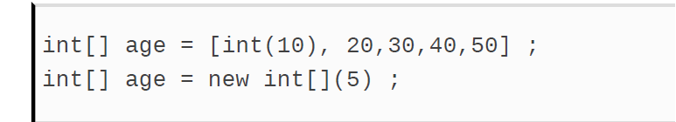
Dynamic Array
Dynamic arrays can be initialized inline or using the new operator.

Slide 90
Array properties
Index:
This property used for reading individual array elements is supported by all types of arrays, except for the string type.
Writing individual element is supported for dynamic arrays, fixed arrays, and the bytes type only.
Writing is not supported for string and fixed sized byte arrays.

Slide 91
Array properties
push:
This property is supported by dynamic arrays only.
length:
This property is supported by all arrays from read perspective, except for the string type.
Only dynamic arrays and bytes support modifying the length property.

Slide 92
The Bytes Array
The bytes array is a dynamic array that can hold any number of bytes.
It is not the same as byte[]. The byte[] array takes 32 bytes for each element whereas bytes tightly holds all the bytes together.

Slide 93
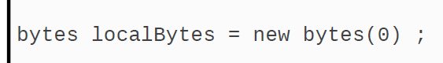
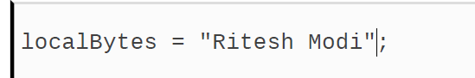
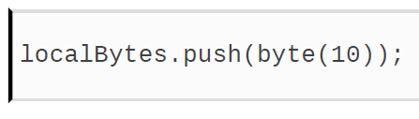
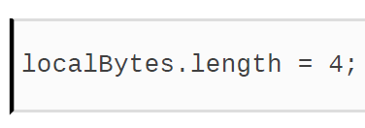
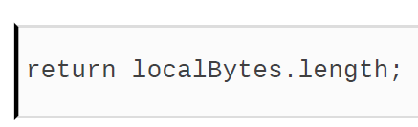
Bytes Array
Bytes can be declared
Bytes can be assigned
Values can be pushed
Provides read/write length property

Slide 94
The String
Strings are dynamic data types that are based on bytes arrays. With some additional restrictions
Strings cannot be indexed
Cannot be Pushed or increased
Do not have the length property
To perform any of these actions on string variables, they should first be converted into bytes

Slide 95
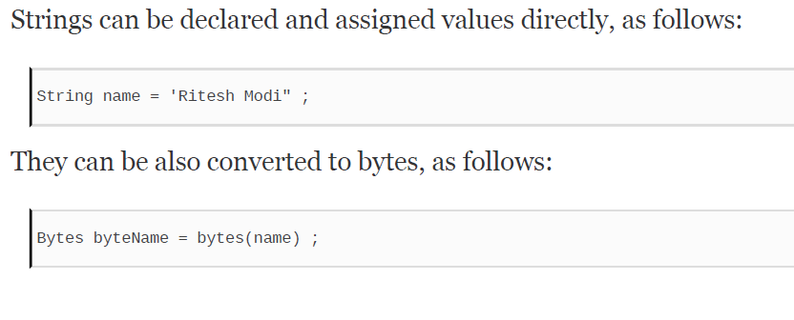
The String: Assignment

Slide 96
Struct / Structure
Structures or structs helps implement custom user-defined data types.
A structure is a composite data type, consisting of multiple variables of different data types.
They are very similar to contracts; however, they do not contain any code within them. They consist of only variables.
For Example. you want to store related data together. information about an employee: name, age, marriage status & bank account numbers.
To represent this, these individual variables related to single employee, a structure in Solidity can be declared using the struct keyword.
Notes:
Technically contracts are composed of two constructs—variables and functions

Slide 97
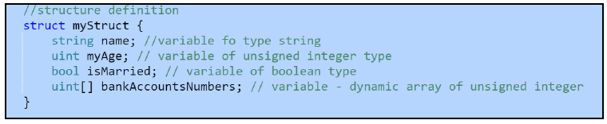
Struct / Structure
To create an instance of a structure, the following syntax is used. There is no need to explicitly use the new keyword. The new keyword can only be used to create an instance of contracts or arrays
Multiple instance of struct can be created in functions. Structs can contain array and the mapping variables, while mappings and arrays can store values of type struct
Notes:
Technically contracts are composed of two constructs—variables and functions

Slide 98
Functions
Functions are the heart of Ethereum and Solidity.
Ethereum maintains the current state of state variables and executes transaction to change values in state variables.
When a function in a contract is called or invoked, it results in the creation of a transaction.
Functions are the mechanism to read and write values from/to state variables.
Functions are a unit of code that can be executed on-demand by calling it.
Functions can accept parameters, execute its logic, and optionally return values to the caller.
Solidity provides named functions with the possibility of only one unnamed function in a contract called the fallback function.
Notes:
Technically contracts are composed of two constructs—variables and functions

Slide 99
Functions
Functions are the heart of Ethereum and Solidity.
Ethereum maintains the current state of state variables and executes transaction to change values in state variables.
When a function in a contract is called or invoked, it results in the creation of a transaction.
Functions are the mechanism to read and write values from/to state variables.
Functions are a unit of code that can be executed on-demand by calling it.
Functions can accept parameters, execute its logic, and optionally return values to the caller.
Solidity provides named functions with the possibility of only one unnamed function in a contract called the fallback function.
Notes:
Technically contracts are composed of two constructs—variables and functions

Slide 100
Modifier
Modifier is always associated with a function.
It has the power to change the behavior of functions that it is associated with.
It is like a function that will be executed before execution of the target function.
Example: you want to invoke the getAge function but, before executing it, you would like to execute another function that could check the current state of the contract, values in incoming parameters, the current value in state variables, and so on and accordingly decide whether the target function getAge should be executed.
Helps in writing cleaner functions without cluttering them with validation and verification rules.
Moreover, the modifier can be associated with multiple functions.
This ensures cleaner, more readable, and more maintainable code.
Notes:
Technically contracts are composed of two constructs—variables and functions

Slide 101
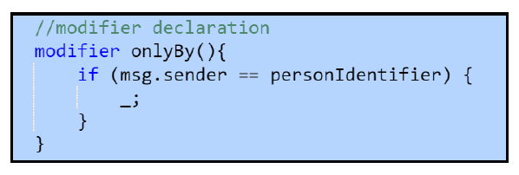
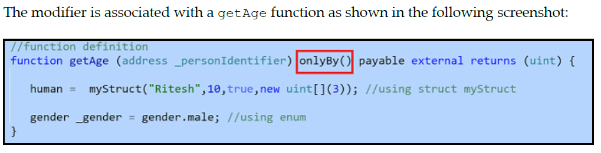
Modifier
Notes:
Technically contracts are composed of two constructs—variables and functions

Slide 102
Events
Events are fired from contracts such that anybody interested in them can trap/catch them and execute code in response.
Used primarily for informing the calling application about the current state of the contract by means of the logging facility of EVM.
Used to notify applications about changes in contracts and applications can use them to execute their dependent logic.
Instead of applications they keep polling the contract for certain state changes; the contract can inform them by means of events.
Declared within the contract at the global level and invoked within its functions.
Declared using the event keyword, followed by an identifier and parameter list
Parameters can be used to log information or execute conditional logic.
Event information and its values are stored as part of transactions within blocks.
Notes:
Technically contracts are composed of two constructs—variables and functions

Slide 103
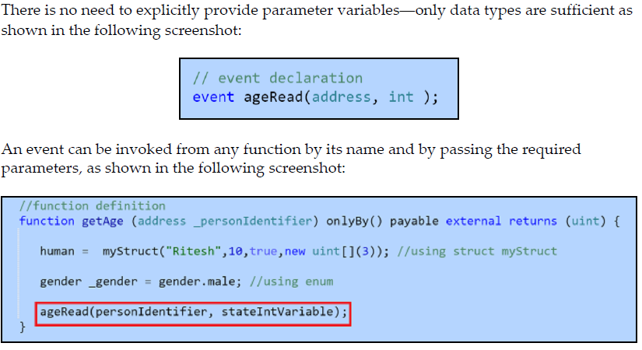
Events
Notes:
Technically contracts are composed of two constructs—variables and functions

Slide 104
Enumeration
enum keyword is used to declare enumerations.
Help in declaring a custom user-defined data type.
enum consists of an enumeration list, a predetermined set of named constants.
Constant values within an enum can be explicitly converted into integers.
Each constant value gets an integer value, with the first one having a value of 0 and the value of each successive item is increased by 1.
An enum declaration uses the enum keyword followed identifier and a list of enumeration values within the {} brackets.
Enum declaration does not have a semicolon as its terminator and that there should be at least one member declared in the list.
Notes:
Technically contracts are composed of two constructs—variables and functions

Slide 105
Enumeration
An example of enum is as follows:
enum gender {male, female}
A variable of enumeration can be declared and assigned a value as shown in the following code:
gender _gender = gender.male ;
It is not mandatory to define enum in a Solidity contract.
enum should be defined if there is a constant list of items that do not change
Notes:
Technically contracts are composed of two constructs—variables and functions

Slide 106
Data Type
Solidity data types can broadly be classified in the following two types:
Value types
Reference types

Slide 107
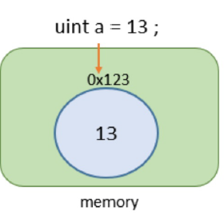
Data Type - Value Type
A type is referred as value type if it holds the data (value) directly within the memory owned by it.
Value types are types that do not take more than 32 bytes of memory in size.

Slide 108
Data Type - Value Type
Solidity provides the following value types:
bool: The boolean value that can hold true or false as its value
uint: These are unsigned integers that can hold 0 and positive values only
int: These are signed integers that can hold both negative and positive values
address: This represents an address of an account on Ethereum environment
byte: This represents fixed sized byte array (byte1 to bytes32)
enum: Enumerations that can hold predefined constant values

Slide 109
Passing by Value
When a value type variable is assigned to another variable or when a value type variable is sent as an argument to a function, EVM creates a new variable instance and copies the value of original value type into target variable.
Changing values in original or target variables will not affect the value in another variable.
Both the variables will maintain their independent, isolated values and they can change without the other knowing about it.

Slide 110
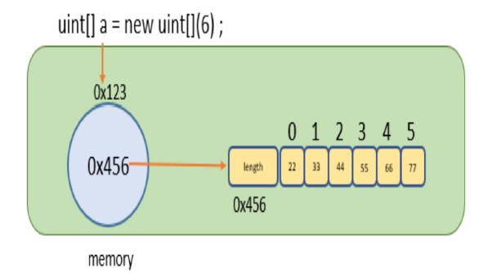
Data Type - Reference types
Reference types, unlike value types, do not store their values directly within the variables themselves.
Instead of the value, they store the address of the location where the value is stored.

Slide 111
Data Type - Reference types
Solidity provides the following reference types:
Arrays: These are fixed as well as dynamic arrays.
Structs: These are custom, user-defined structures.
String: This is sequence of characters. In Solidity, strings are eventually stored as bytes.
Mappings: This is similar to a hash table or dictionary in other languages storing key-value pairs.

Slide 112
Passing by reference
When a reference type variable is assigned to another variable or when a reference type variable is sent as an argument to a function, EVM creates a new variable instance and copies the pointer from the original variable into the target variable
Both the variables are pointing to the same address location.
Both the variables will share the same values and change committed by one is reflected in the other variable.

Slide 113


Storage and memory data locations
The amount of gas you will use during a transaction depends on the data location you use in your smart contract. Hence, the best practice is to write an optimized code that uses a minimum amount of gas.
Storage
Global
Permanent
State Vars
Expensive
Memory
Within Function
Temporary
Function Parameter
Cheaper

Slide 114
Memory Location: Rules
The storage and memory keywords are used to reference data in storage and memory respectively.
Contract storage is pre-allocated during contract construction and cannot be created in function call. After all, it makes little sense to create new variable in storage in a function if it is to be persisted.
Memory cannot be allocated during contract construction but rather created in function execution. Contract state variable is always declared in storage. It makes little sense to have state variable that cannot persist.
When assigning a memory referenced data to a storage referenced variable, we are copying data from memory to storage. No new storage is created.
When assigning a storage reference data to a memory referenced variable, we are copying data from storage to memory. New memory is allocated.
When a storage variable is created in function locally by look up, it simply reference data already allocated on Storage. No new storage is created.

Slide 115
Integers
Integers help in storing numbers in contracts. S olidity provides the following two types:
Signed integers: Signed integers can hold both negative and positive values.
Unsigned integers: Unsigned integers can hold only positive values along with zero. They can also hold negative values apart from positive and zero values.
There could be 32 different declarations of uint with different multiples of of 8, such as uint8, uint16, unit24, as far as uint256 bit.
Similarly, there are equivalent data types for integers such as int8, int16 till int256.

Slide 116
Integers
bool data type can be used to represent scenarios that have binary results, such as true or false, 1 or 0, and so on.
The valid values for this data type are true and false.
It is to be noted that bools in Solidity cannot be converted to integers,.
It's a value type and any assignment to other boolean variables creates a new copy.
The default value for bool in Solidity is false.

Slide 117
Byte
The byte data type Byte refers to 8 bit signed integers.
Solidity has multiple flavors of the byte type. It provides data types in the range from bytes1 to bytes32 inclusive, to represent varying byte lengths, as required.
These are called fixed sized byte arrays and are implemented as value types.
bytes1 data type represents 1 byte and bytes2 represents 2 bytes.
We can also perform bitwise operations such as and, or, xor, not, and left and right shift operations on the byte data type

Slide 118
Byte
The default value for byte is 0x00 and it gets initialized with this value.
A byte can be assigned byte values in hexadecimal format, as: bytes1 aa = 0x65;
A byte can be assigned integer values in decimal format, as: bytes1 bb = 10;
A byte can be assigned negative integer values in decimal format, as: bytes1 ee = -100;
A byte can be assigned character values as : bytes1 dd

Slide 119
Array
Arrays refer to groups of values of the same type.
Arrays help in storing these values together and ease the process of iterating, sorting, and searching for individuals or subsets of elements within this group.
Solidity provides rich array constructs that cater to different needs.
An example of an array in Solidity is as: uint[5] intArray ;
Arrays in Solidity can be fixed or dynamic.

Slide 120
Fixed Arrays
Fixed arrays refer to arrays that have a pre-determined size mentioned at declaration.
Examples of fixed arrays are as follows:
int[5] age ; // array of int with 5 fixed storage space allocated
byte[4] flags ; // array of byte with 4 fixed storage space allocated
Fixed arrays cannot be initialized using the new keyword.
They can only be initialized inline, as: int[5] age = [int(10), 20,30,40,50] ;
They can also be initialized inline within a function later, as: int[5] age ; age = [int(10),2,3,4,5];

Slide 121
Dynamic Arrays
Arrays that do not have a pre-determined size at the time of declaration; their size is determined at runtime.
int[] age ; // Storage is allocated during assignment byte[] flags ; // array of byte with no fixed storage space allocated
The initialization can happen at the time of declaration as follows: int[] age = [int(10), 20,30,40,50] ; int[] age = new int[](5) ;
The initialization can also happen within a function later in the following two different steps: int[] age ; age = new int[](5) ;

Slide 122
Arrays Properties
Due to the multiple types of array, not every type supports all of these properties.
index: This property used for reading individual array elements is supported by all types of arrays, except for the string type. The index property for writing to individual array element is supported for dynamic arrays, fixed arrays, and the bytes type only. Writing is not supported for string and fixed sized byte arrays.
push: This property is supported by dynamic arrays only.
length: This property is supported by all arrays from read perspective, except for the string type. Only dynamic arrays and bytes support modifying the length property.

Slide 123
Enumerations
Enums are value types comprising a pre-defined list of constant values.
They are passed by values and each copy maintains its own value.
Enums cannot be declared within functions and are declared within the global contract.
Predefined constants are assigned consecutively, increasing integer values starting from zero.
It is to be noted that web3 and Decentralized Applications (DApp) do not understand an enum declared within a contract. They will get an integer value corresponding to the enum constant.

Slide 124
Address
“address” is a 20 bytes data type, specifically designed to hold account addresses.
It can hold contract account addresses as well as externally owned account addresses.
Address is a value type and it creates a new copy while being assigned to another variable.
Address has a balance property that returns the amount of Ether available in account and has a few functions for transferring Ether to accounts and invoking contract functions.
It provides the two functions to transfer Ether: transfer & send

Slide 125
Address
Transfer function is a better alternative for transferring Ether to an account than the send function.
Send function returns a boolean value depending on successful execution of the Ether transfer while the transfer function raises an exception and returns the Ether to the caller.
It also provides the following three functions for invoking the contract function:
Call
DelegateCall
Callcode

Slide 126
Mapping
Mappings are one of the most used complex data types in Solidity.
Mappings are similar to hash tables or dictionaries in other languages.
They help in storing key-value pairs and enable retrieving values based on the supplied key.
Mappings are declared using the mapping keyword followed by data types for both key
and value separated by the => notation.
Example of mapping is as: Mapping ( uint => address ) Names ;
uint data type is used for storing the keys and the address data type is used for storing the values. Names is used as an identifier for the mapping

